Slide 1
Sport and Exercise Psychology
Notes:
http://news.yahoo.com/s/ac/20110131/lf_ac/7746304_mothers_hot_sauce_discipline_tactics_land_her_in_hot_water

Slide 2
What is Sport Psychology?
The scientific study of people and their behaviors in the study of sport and exercise
http://news.yahoo.com/s/ac/20110131/lf_ac/7746304_mothers_hot_sauce_discipline_tactics_land_her_in_hot_water

Slide 3
Where would you find a sport psychologist?
Private practice
University and College counseling centers and athletic departments
Sports medicine centers
Elite sports academies

Slide 4
How do you become an ESP?
Earn an undergraduate degree in psychology (clinical or counseling related) with coursework in the sport sciences.
Earn a graduate degree, ultimately a doctorate.
Examine the Division 47 Proficiency in Sport Psychology to identify prerequisite skills and knowledge
Get some research experience.
Get competitive experience at some level.

Slide 5
Teaching (Many teach college; others teach as part of consultations and outreach including workshops, coaching)
Research (Some professional conduct research on topics such as anxiety, injury prevention, exercise adoption, retirement, coaching behaviors, athlete stress, recovery, mental health of athletes)
Practice (Many ESP professionals are in private practice. They work counseling centers, sports medicine, wellness settings and health clubs.)

Slide 6
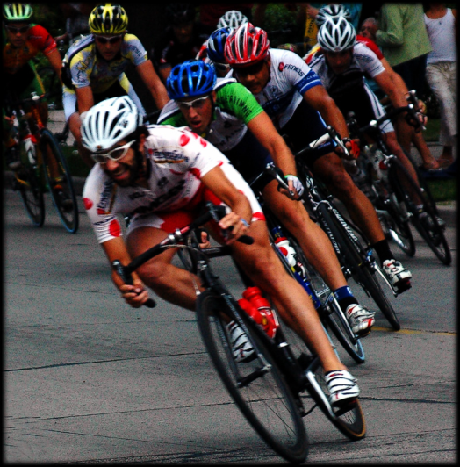
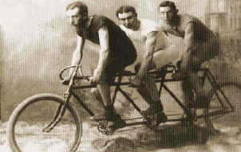
The History
In many ways it is not a new field – it has been an area of scientific study for approximately 100 years
Its roots are in physical education and coaching
Early research was conducted on cycling and audience effects by Norman Triplett in 1897

Slide 7
More History
G. Stanley Hall reported on benefits of physical education in 1908
Coleman Griffith has a sport psychology lab at University of Illinois in 1925. He studied personality, motor learning and motivation and also served as a consultant to major league baseball, the Chicago Cubs.
A lack of interest shut the place down.
1984 Olympics

Slide 8
Sport Performance Context
Physical
Tactical
Technical
Mental

Slide 9
Why would anyone seek a sport psychologist?
To improve or optimize performance to help make performance more effective
To help overcome obstacles that prevent the reaching of potential
To assist with adopting or maintaining an exercise program
To facilitate efficient/healthy functioning of sport or other teams (team building, conflict)

Slide 10
Stages of Intervention for a Sport Psychologist
Introductions/ Gaining Entry
Stage 1: Rapport Building
Stage 2: Assessing the Mental Needs of the Performer
Stage 3: designing an Intervention
Self determination theory
Achievement Goal Theory
Stage 4: Ongoing Monitoring and Assessment
Stage 5: Evaluation and Withdrawal

Slide 11
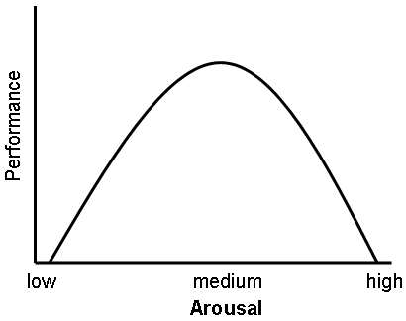
Yerkes-Dodson law
How can stress and nervousness affect athletes

